Slide 1

Time
management

Slide 2

Discussion
Who here has ever said,
‘I don’t have enough time’?

Slide 3

You're not alone. Between school, homework, sports, clubs, chores, social media, and trying to sleep, you’ve got a lot going on.
But here’s the truth:
We all get the same 24 hours a day. What you do with them is what makes the difference.

Slide 4
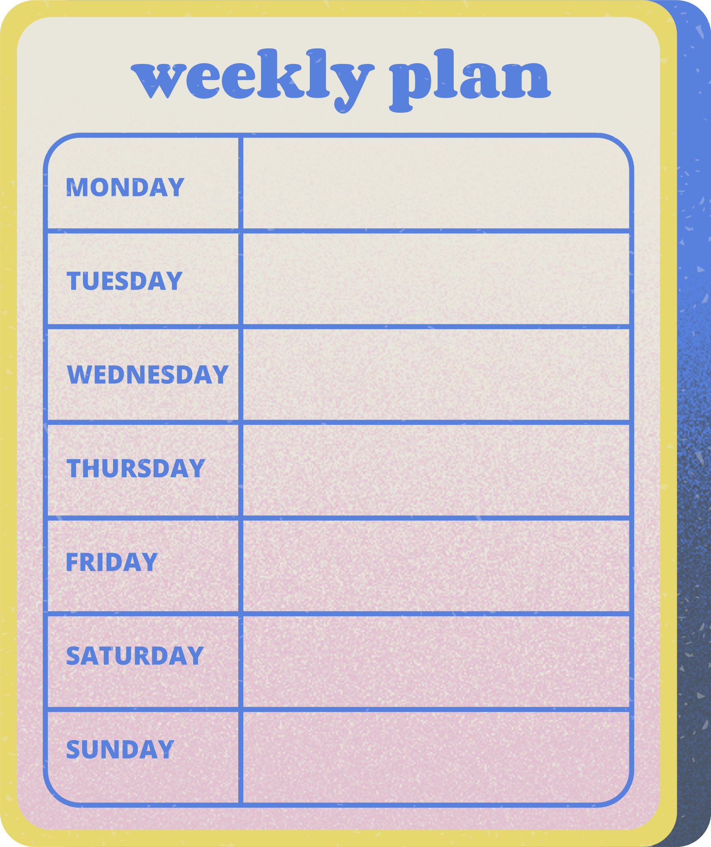
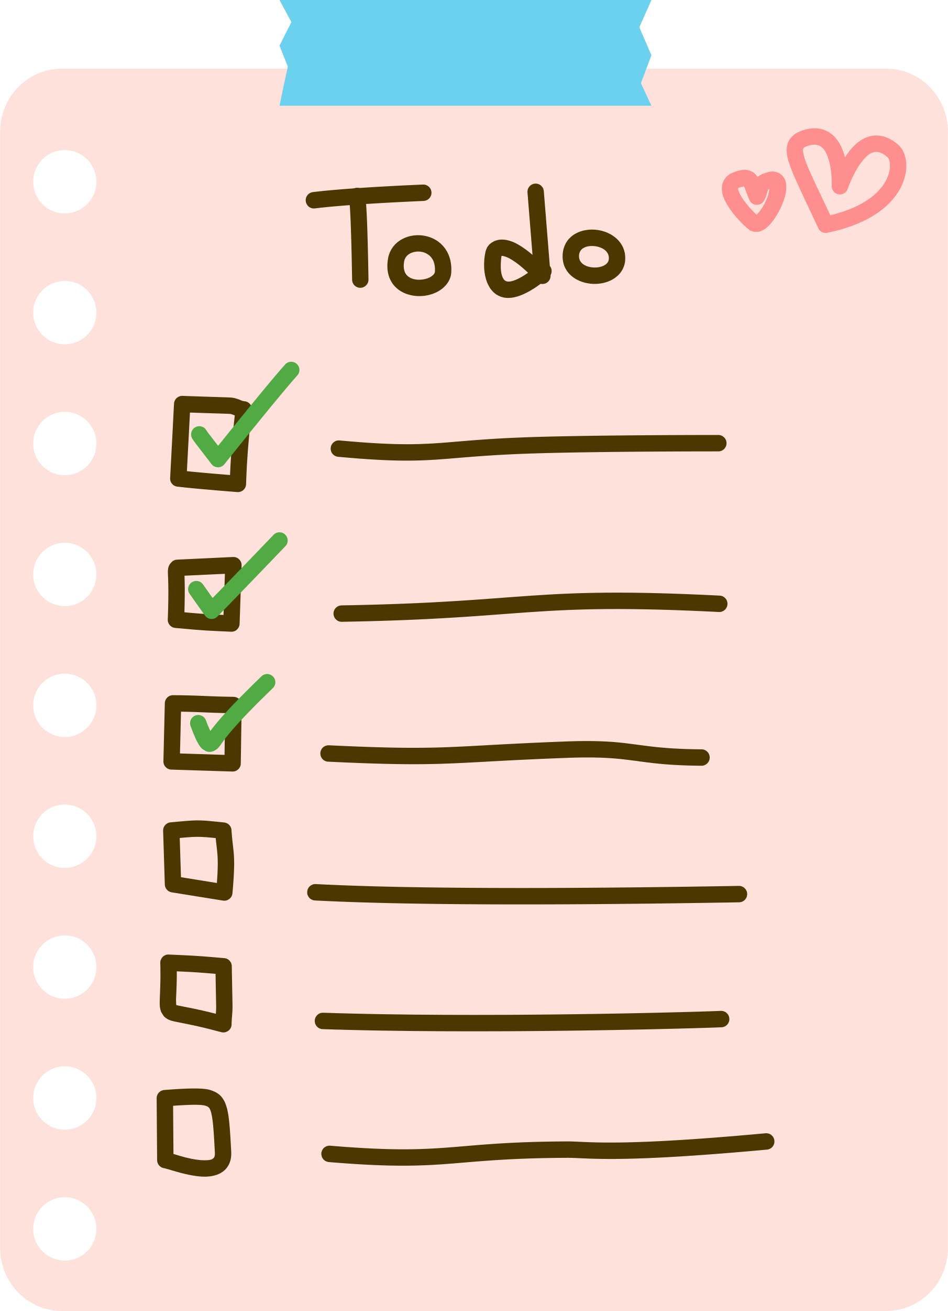
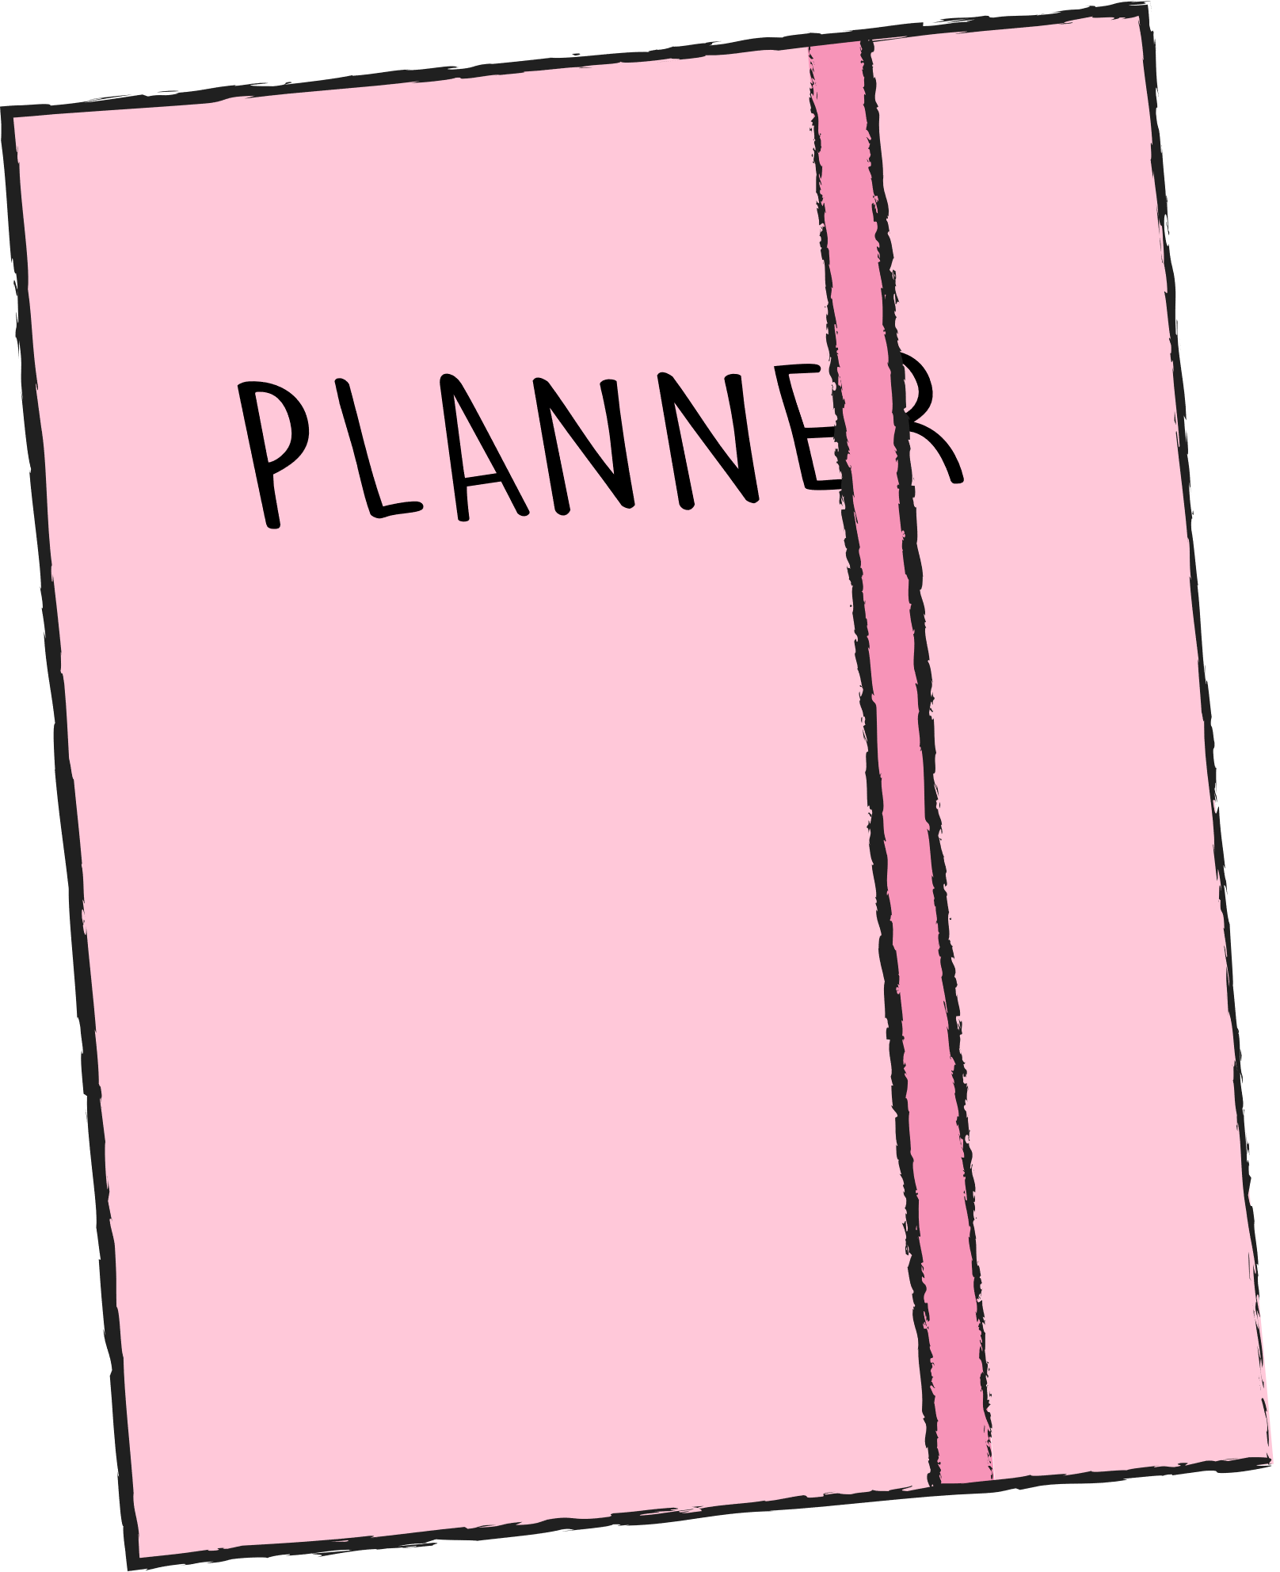
Use a to-do list or an appointment book
  Write down responsibilities to avoid forgetting.
  Reduces mental clutter and stress.
  Helps visualize and organize tasks.

Slide 5
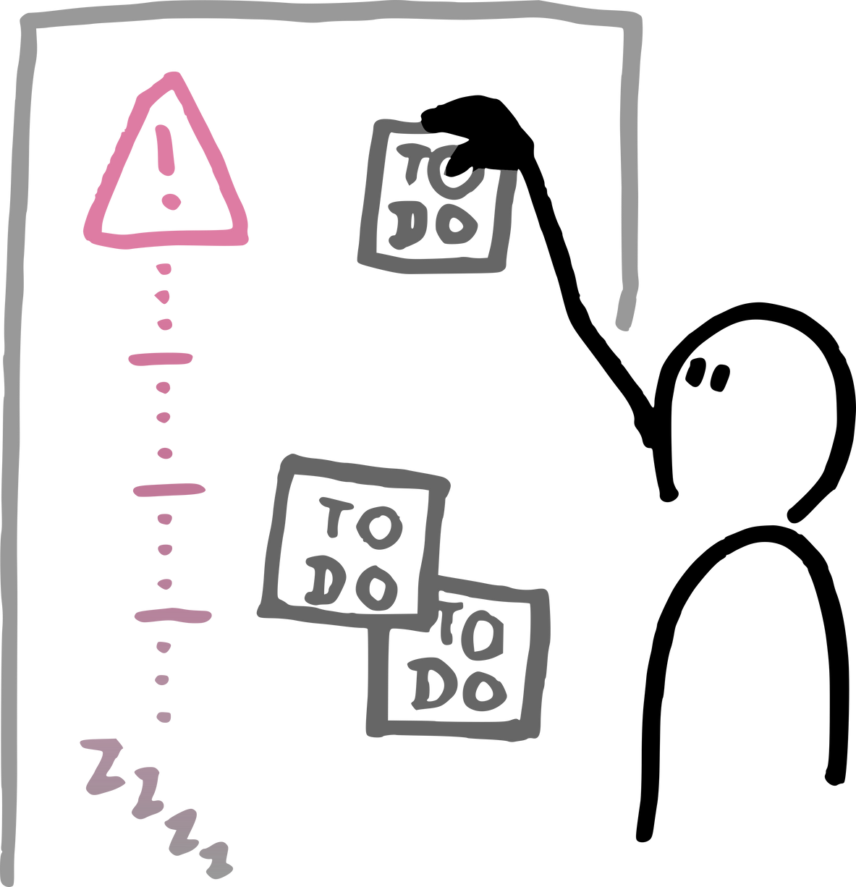
Prioritize your tasks
  Focus on important and quick tasks first.
  Gain peace of mind by tackling high-priority items.
  Use prioritization methods (e.g., ABC method, Eisenhower Matrix).

Slide 6

Break large tasks into smaller pieces
  Makes daunting tasks manageable.
  Encourages starting and maintaining momentum.
  Use step-by-step planning.

Slide 7
Escape Distractions if Necessary
To-Do Lists
Planners & Calendars
Time Blocking
Pomodoro Technique
Keep it short
Cross off as you go
Use paper or digital
Plan deadlines, tests, and events ahead
Break your day into chunks
Schedule breaks
25 minutes work, 5 minutes break (repeat)
Helps with focus and prevents burnout

Slide 8

Limit Distractions
  Track time spent on distractions.
  Eliminate unnecessary interruptions.
  Schedule enjoyable activities to stay motivated.

Slide 9
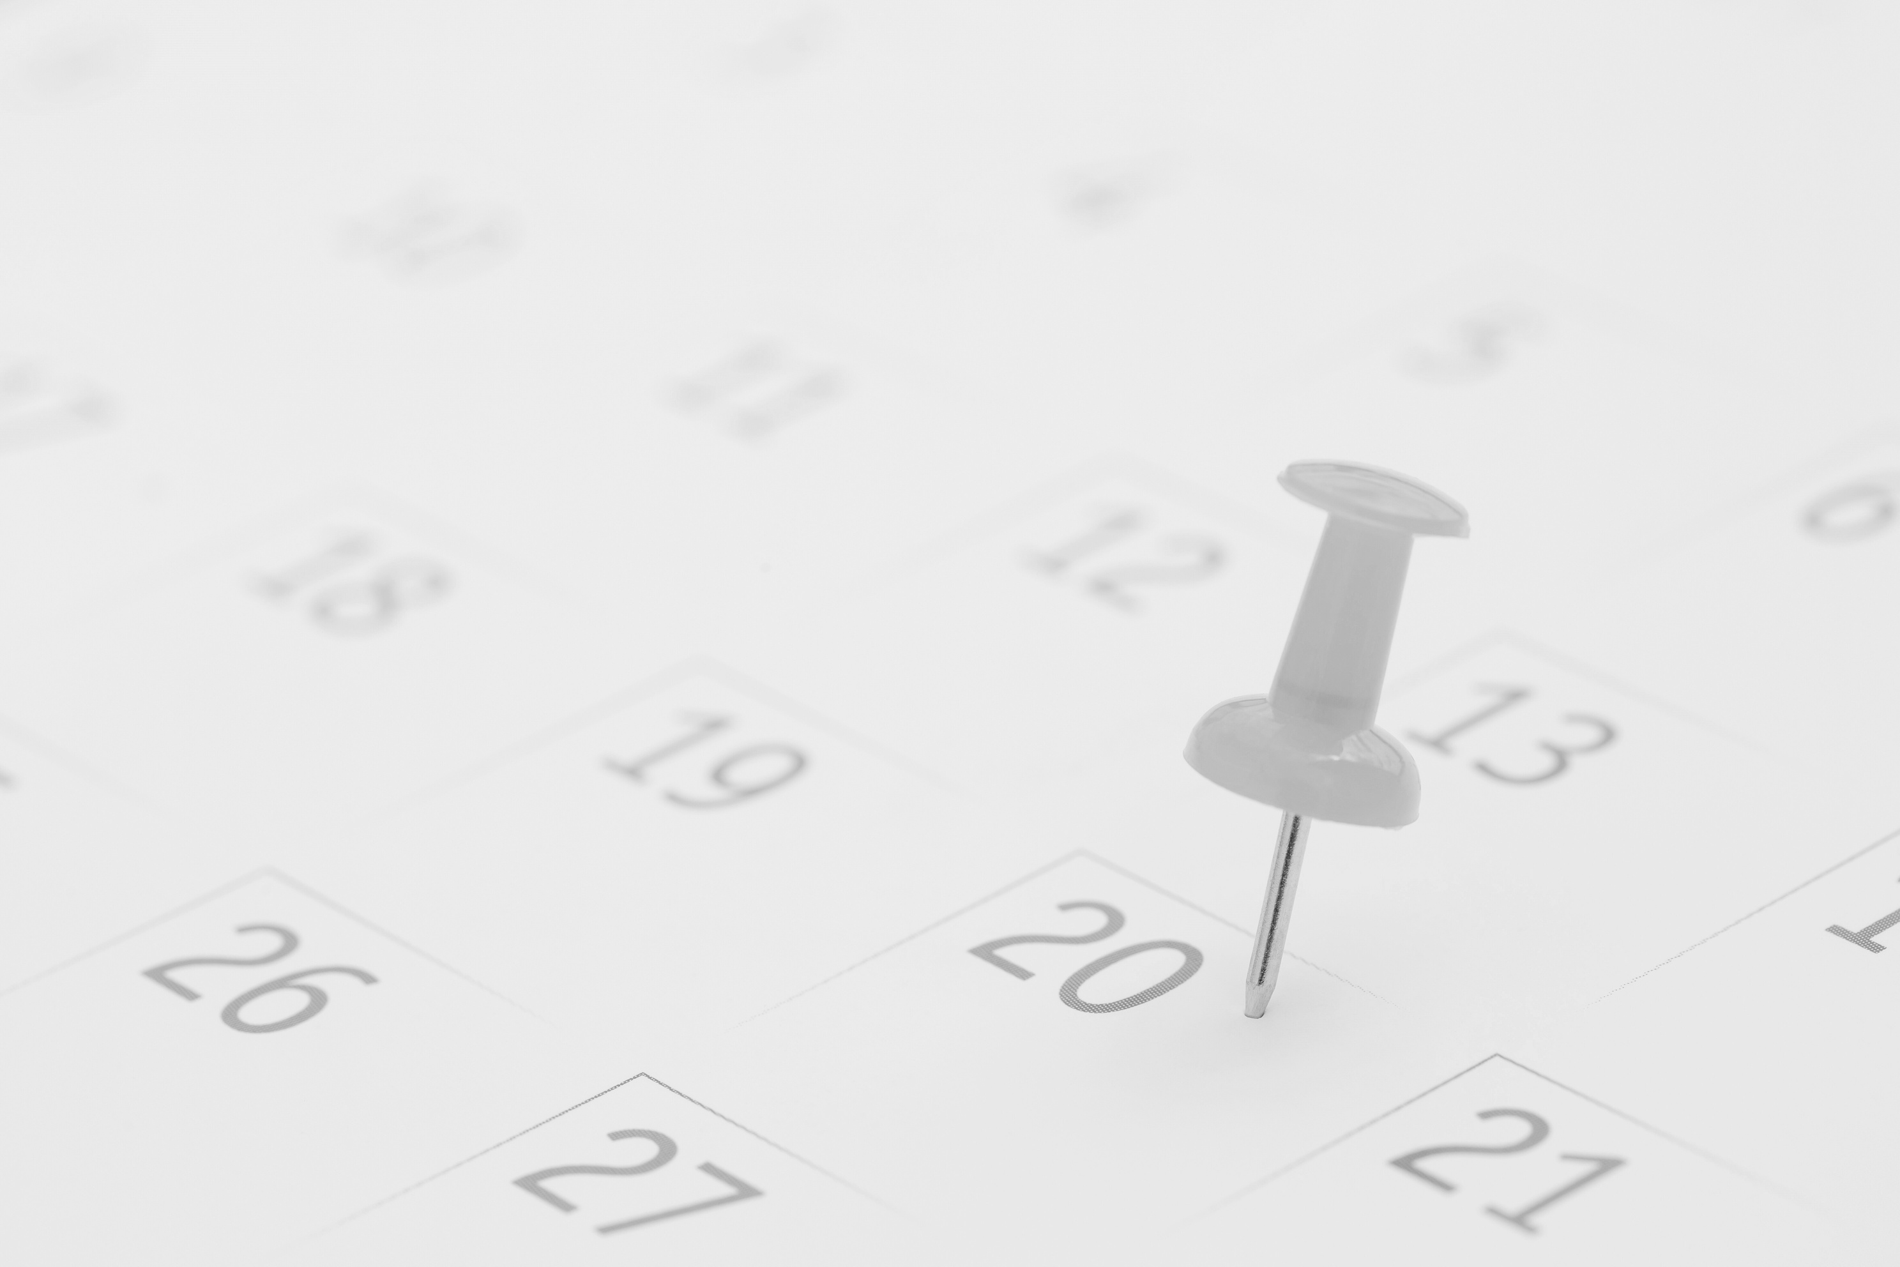

Allow Time Between Tasks
  Arrive early to appointments.
  Bring something productive to do while waiting.
  Reduces stress from delays and transitions.

Slide 10
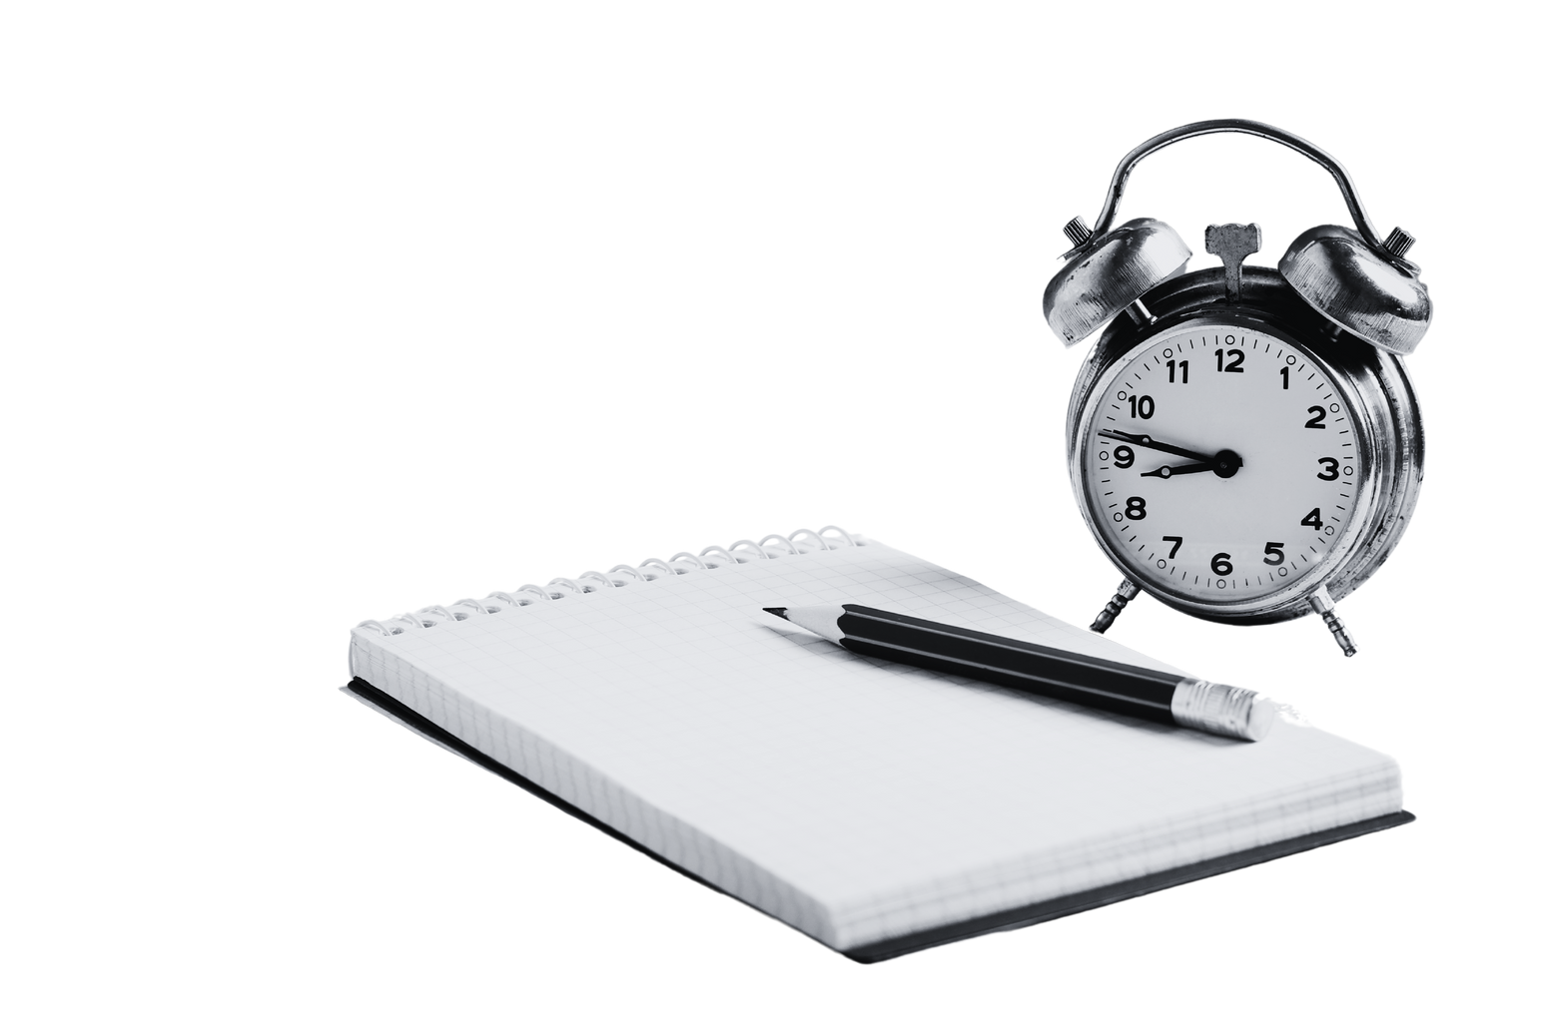
Embrace Imperfection
  Accept that perfection isn’t always achievable.
  Focus on completing tasks adequately.
  Improve later if needed.

Slide 11

Takeaways
Time management results in less stress, more freedom
Use simple tools such as lists, planners, and time blocks
Small changes now make a big difference later!

Slide 12

Discussion
What’s one thing you’re going to change about how you use your time this week?

